Slide 1


Value-Based Operations and Engineering Services

Slide 2

Advancing Value Through Your CBC
Notes:
We have worked with CBCs and licensing agencies
Industrial Engineer -- Glass ½ full or empty,
2x as big as needs to be
The need is to have a completely connected system without waste and I will talk to you about systems that help you get there.
Normally we ‘industrial engineers get stuck looking for efficiency and I will talk a little about that, but we really care about what is valuable to your children and families

Slide 3
The Need
Beliefs
Values
Actions
Notes:
You Must align your system to the core of your employees
General Employee in a for profit business….
“this job found me”
I thought it would be interesting
A friend did this, so I thought I would try
Suddenly I found myself here
I have done a bunch sessions with CBCs and employess say
I wanted to make a difference
I was in the system and want to give back
So when you think about your system, you have to tap into their
Beliefs
Values
Drive this to actions
This comes from the Oz principle and James Clear “Atomic Habits”
Your system has to deliver this – all the software, supervisor interactions and team interactions

Slide 4
Barriers to Effective Action
The Ability to Act
Notes:
Actions are what bring results that we want.
But that brings me to my introduction of why I am involved in this meeting.
Your employees that are out in the field every day may not be able to get to the ACTIONS that drive the results
Have you Defined what actions your employees should be doing
Have you designed the best system to put them in place to be doing the actions that align with the results you have defined BUT that have also tapped into their identity of why they joined this effort
I hope today you will see some actions and ideas for implementation that will help you with the system you design. This is what CBCs are all about…. You and your leadership team get to design the system that gets employees to the right actions and results for kids

Slide 5
Lean is all About Value
Value Defined
Child/Family Focus
ALL EMPLOYEES DELIVERING VALUE
Transform or Moves the Case forward
Done Right the First time
Notes:
So We have been working in the child welfare industry for 3 years. I love it.
We are experts at what is called lean manufacturing. This was developed in manufacturing but applies well in so many different industries
There are a lot of tools in the “Lean” toolbox but from the most basic perspective, Lean starts with defining value – When you talk about actions…..
Difference – Value added, Vs Value
Define value of what every action is – Outcome oriented – align your value adding actions
We have adopted a definition of value for the work with child and welfare:
Child/Family Focus
Transforms or Moves the Case forward
Done Right the first time
So what is the opposite of Value? WASTE
Waste is everything other than value – Think about this – Its everything that doesn’t line up with #1,2,3
If someone asks you “what is lean?” your answer should simply be to define value, and remove waste. There are a lot of complex answers, but that is lean at its Core.
So can Lean be applied in child and welfare? Absolutely

Slide 6
Optimize Value
Lean Thinking
NEED
SATISFACTION
VALUE ADDED
Notes:
So how do we optimize value ?
Collapse lead times – Explain image
Nobody wants long wait times for
Dinner/healthcare
Your employees don’t want wasteful tasks to take up their time before they can get back to why they joined this career.
Your children and families cant wait for the ‘system’ to wait on them.
Manufacturing – Inside a managed environment
We cannot take the worker child visits that are supposed to happen at 2 months, 3 months, and 4 months, and do them all at once. That’s a big difference.
BUT we can make for certain, that we are using evidence based practices that shorten the case and we desperately serving these families with the smallest amount of waiting possible.
Lean done well is commonly very exciting to employees doing the work. Their values are being displayed in actions. Not barriers

Slide 7
Value Stream Mapping
How Do You See Value?
Permanency
Incoming
Process 1
Process 2
Process 3
2 Days
4 Days
6 Days
4,743 HRS
235 HRS
5 Hours
1 Hour
8 Hours
REWORK = EXTRA TIME
Notes:
So how do you actually see how this is playing out for your employees in your organization? We have a tool we call value stream mapping.
This is a simple 3 step process represented on this slide could take us all day.
Note the 3 processes, and the times under the steps. Something very interesting is we are not only focusing on the steps, we are focusing even more on the TIME BETWEEN THE STEPS
On the far right you see what we call the value added ratio
Compares the Value Added Time, to the waiting or wasted time.
It is typical in a business to see that only 5% of the total lead time or even time spent by employees is value added for the customer.
Also note at the bottom, anytime you see a process that must to back to earlier steps, it is REWORK. That is one of the worst forms of waste,
Energized Employee Story
Waste – Waiting, Defects/rework, overprocessing
Normally VSM between 50 and 125 steps.
This is the first step in seeing the overall process and PRIORITY for where you should focus your system improvement efforts.
This is a strategic planning level activity to observe and improve this every year.
This process can be done on a process specific basis or for a group of systems.
This is a great first step for lean improvements

Slide 8
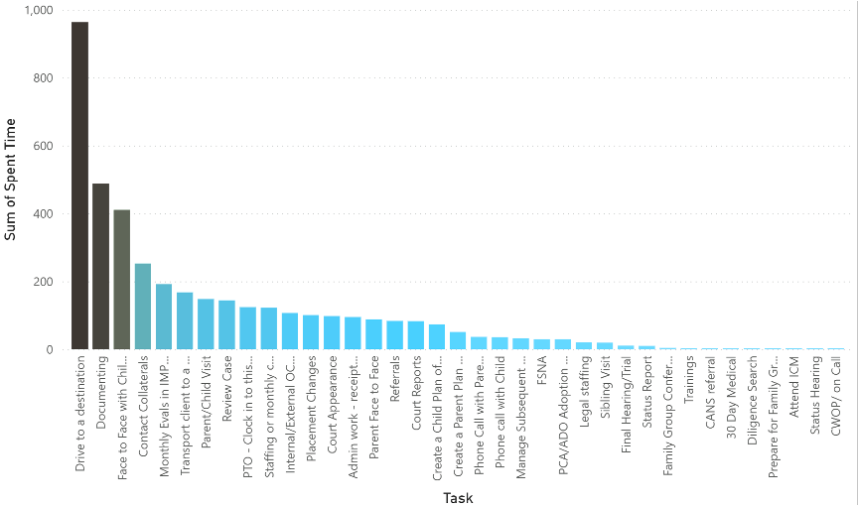
SEEING THE VALUE
We Studied Where the Time Goes
Notes:
So lets take that idea of the Value Stream and apply it to some ideas of improvements.
50-125 steps – Need to understand what wastes we see
State? Other departments?
One Item we have done is to understand the work that permanency specialists are doing.
We did a time study that involved about 3000 hours of permanency specialist work.
You see a chart of the main tasks and how much time they spent on each one over the course of the time study.
The results were a little surprising.
So let me paint a picture for you. These employees value:
Moving cases forward
Helping children and families
Making a difference
The thing they get to spend the most time on is NON VALUE ADDED – remember what we can non value add? WASTE
As you can see, the top two items were non value added
This is different for each geography and system.
These are the barriers I was talking about earlier.
This is how we see the big picture with a value stream map, and then start to boil it down into tactical actions.

Slide 9
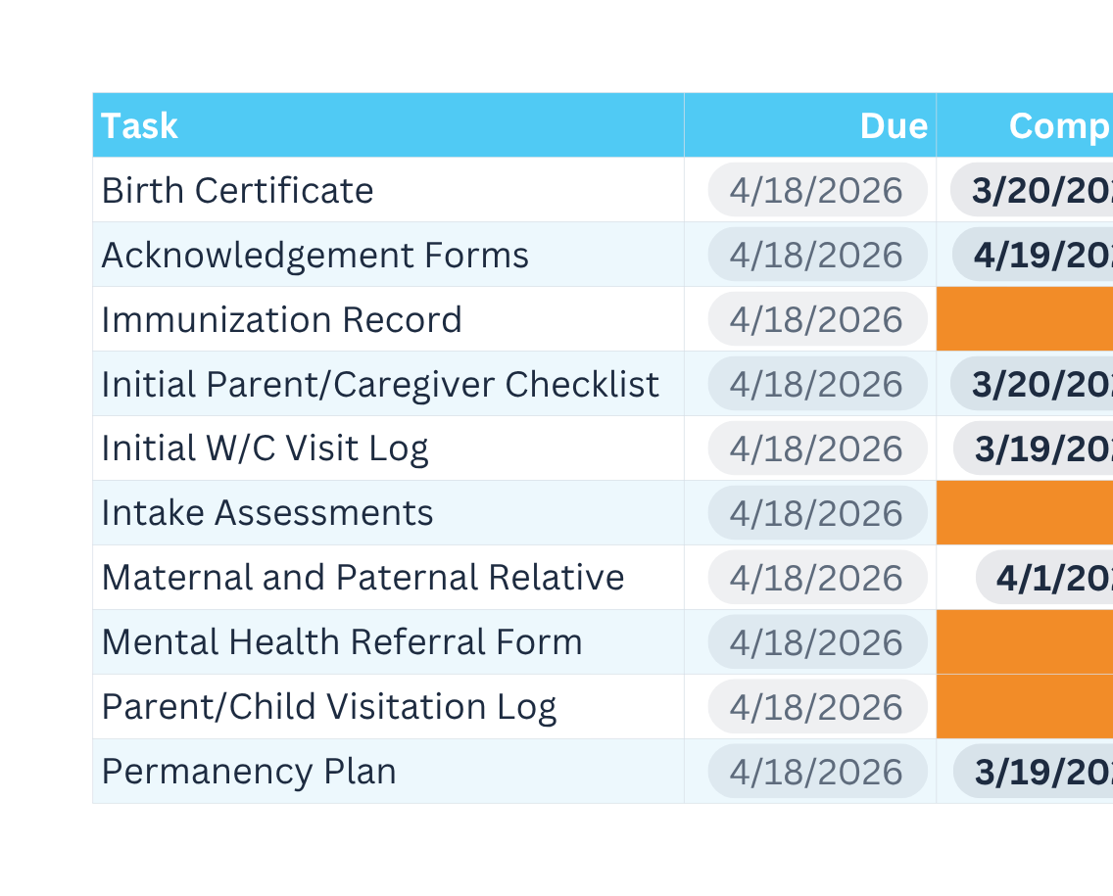
REALTIME DATA
Manage the Value Stream
Obvious and Easy to Take the Next Steps
Notes:
So this is the kind of information that is helpful but then the question comes up of How do we prioritize all this information and where do we start?
We cant just tell people get more efficient, or don’t make those wastes….
We also cannot take action on every item every employee wants to improve.
If we measure what matters – normally you get 10-15%improvement in efficiency just by measuring it
This is where AI could have some impact as discussed yesterday….. Tasks that are waiting…..

Slide 10
Employees Delivering Value
KPIs and Dashboards
ACTIONABLE
SIMPLE
VALUE
Lead indicators that are actionable
KPIs should be simple
Tie your dashboards to value
Notes:
A couple notes of how we should focus on KPIs
We should care about the lead indicators and behaviors and actions. If we are 100% focused on lead indicators and making certain those tasks are always supported, the results will come.
Define the value stream
Define the tasks that are absolutely critical
Make measurement of milestones absolutely key
Don’t spend a bunch of money on a leadership dashboard unless it is reporting key tasks that indicate behaviors that lead to outcomes.
Obsessing about how out of shape I am is the wrong focus, but focusing on # of times in the gym, and # of healthy meals are indicators of behaviors….
Make it simple. Your employees wont care if your dashboard is:
out of date
doesn’t care about actions
doesn’t align with their values…..
The Organization succeeds when all your employees understand value, you have a system that removes barriers for them to act and then you work to support and appreciate them all day long.

Slide 11
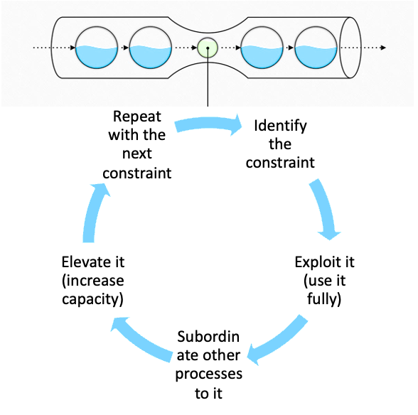
THEORY OF CONSTRAINTS
A management philosophy that views any manageable system as being limited in achieving its goals by a very small number of constraints.
Bottleneck or Constraint
Intake
Face 2 Face
Court Reports
Training
Notes:
That brings me to what we call the theory of constraints.
Any manageable system is limited by a VERY SMALL NUMBER of constraints
Think back to the idea of the VSM
We have one major line that is a continuum of activities and people.
Some examples:
Provider capacity
Parents
Documentation
# of cases
Let me give you some indicators of a bottleneck:
The step that takes the longest
The location that has mountains of work
A process you can never get ‘right’
This idea was developed and a book is written about it called “THE GOAL”
It’s a great read talking about a group of boy scouts hiking and they had a slow kid. If the goal is to arrive at one location all together, then the slow kid cannot always be the slow kid…. We have to remove their backpack, pace the whole crew off that one spot and then alleviate any stoppages of that bottleck.
One step in the process may be limiting your entire organization

Slide 12
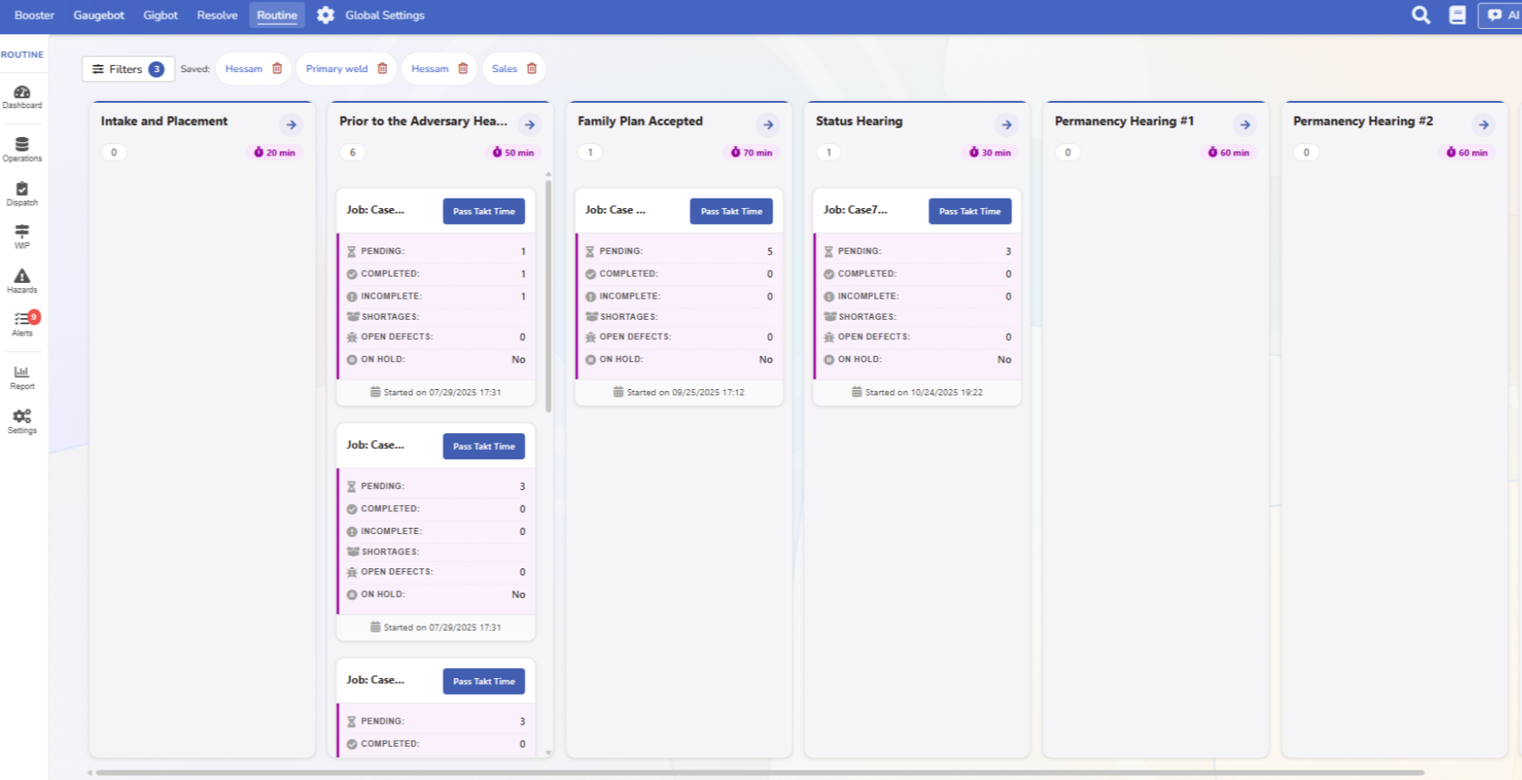
THEORY OF CONSTRAINTS
Notes:
I know I just taught you, but where is the bottleneck between these 6 processes?
Notice it is easy for your supervisor….where the bottleneck is.
This is a lead indicator (number of cases stuck in each area) of how long the cases will take or whether our results will be good.

Slide 13
IMPROVING THE SYSTEM
Culture and Where to Start
Train Everyone to see Value
Identify your Biggest constraints
Practice Kaizen
Map the Value Stream
Notes:
So you say “Forrest, this is great but you have thrown a bunch at us, where do we start?”
Follow the steps
create a map
Train on Waste – all employees
Identify your biggest constraints in a massive visual way
Practice Kaizen
Kaizen means to break apart and improve
Here is what a Kaizen event looks like : THE MOST IMPORTANT PART
We have identified a major bottleneck
We form a team of front line employees, AND leaders
All people have a voice
You focus on a major problem
You study it
You spend a week improving it, the process, the instructions, the change
For example, one organization we worked with showed a process map of silos inside the parent organization. We redeveloped their team in a Kaizen event to be able to support each other without waiting on silos
Then after that, we monitor it and tweak it.
Practicing Kaizen also means you have a system for soliciting improvement ideas and rewarding employees for it. Minor Kaizen – Reward it!

Slide 14
IMPROVING THE SYSTEM
IMPACTS
Attack Problems
‘We consistently have issues here…”
Focus on Results -
‘50% Reduction’
Develop Teamwork
‘I have help and a team’
Give Individuals Tools
‘I can see problems’
Notes:
So lets talk about some results:
We have worked in organizations where we have seen the following results:
Bottleneck processes that formerly took 60 days now take 5
Licensing that cut the licensing times in half……. – Think about that, if you simply put in place a process that cuts the time in half, that means you have half as many weekly meetings with that family to license them
Team members who felt isolated, now belong to a team and an initiative
Struggling team members can see the next step

Slide 15
Its not the time it takes to take the take that takes the time; it’s the time between.
-Roy Sheider
Notes:
Lastly, I will unpack a quote from the actor in Jaws Roy Sheider. “It’s not the time it takes to take the take that takes the time; it’s the time it takes between the takes.”
In your CBC, you have hundreds of tasks that lead to good outcomes. 1 day faster or ½ a day faster per task may be months better for children and families.
Focus on your system
Engage your employees
Constantly improve
Your organization can commonly move forward if you know where the high priority bottlenecks are.

Slide 16
What questions
do you have?

Slide 17
www.TechamSolutions.com

