Slide 1



Stability
Saves
Notes:
Good afternoon! What a great day!
Our presentation today is a short impact showcase, not a detailed program presentation. The goal is to give practical ideas that can be applied in your own programs.
But before we jump into it, I know this slide is titled stability saves, but let’s start with a question (take a minute to answer in your head– unless you feel energetic and want to shout it out!: What does instability cost us?
Many times we think of this in financial terms
But what does it cost a child?
A Family?
A workforce?
An entire system?

Slide 2

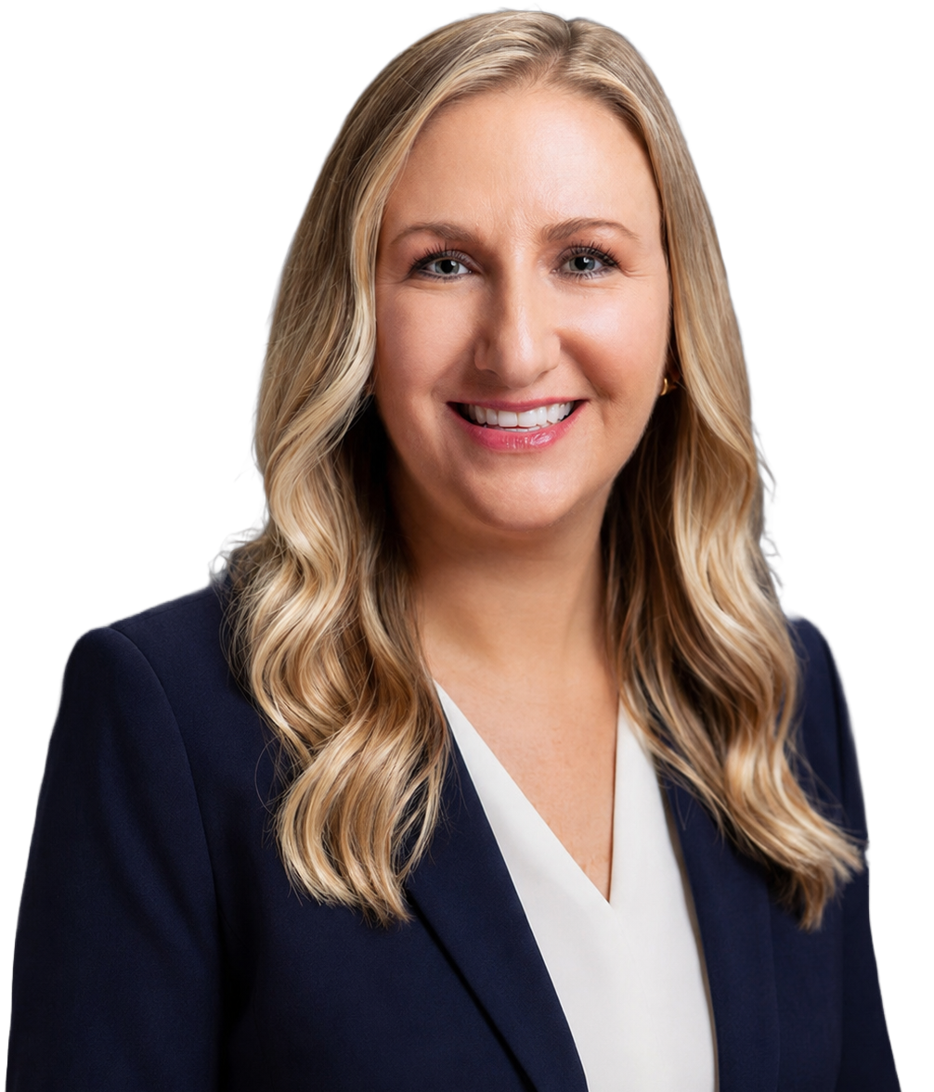
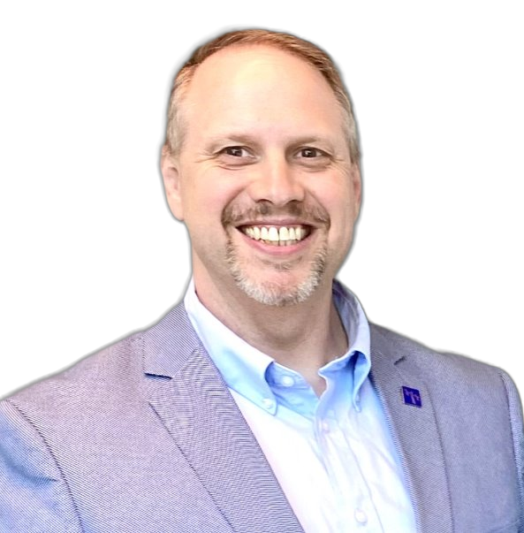


Laurie Stern
Chief Operating Officer
Shawn Brown
State Director
Brings more than 25 years of experience in child welfare and human services
Leads operational strategy and performance across Thompson’s growing multi-state service footprint
Focuses on service quality, team accountability and sustainable execution
State Director (TN, SC & KY) at Thompson Child & Family Focus ​
Previous Experience: 25+ years of executive and senior leadership across FL, NC, GA, SC & KY systems; former Georgia DFCS County Director; U.S. Army Veteran; M.S. Clinical Counseling; UGA Carl Vinson Institute graduate with advanced training from Leadership Pipeline and Leadership Essentials.
v
Notes:
Shawn and I are standing here and as you can see together we have spent 50 years working in child and family services (I know, we started as teenagers)!)
And one thing we have learned, is that instability is expensive in ways we don’t always measure.
Stability is not just a youth outcome. It is a fiscal strategy. Every day a high-acuity teenager remains in a stable setting is a day the system does not pay the compounding costs of disruption.
I know I am speaking to the choir on this.

Slide 3

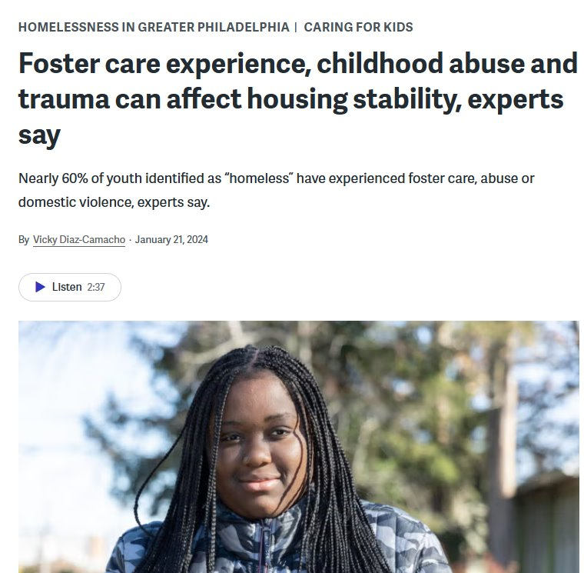
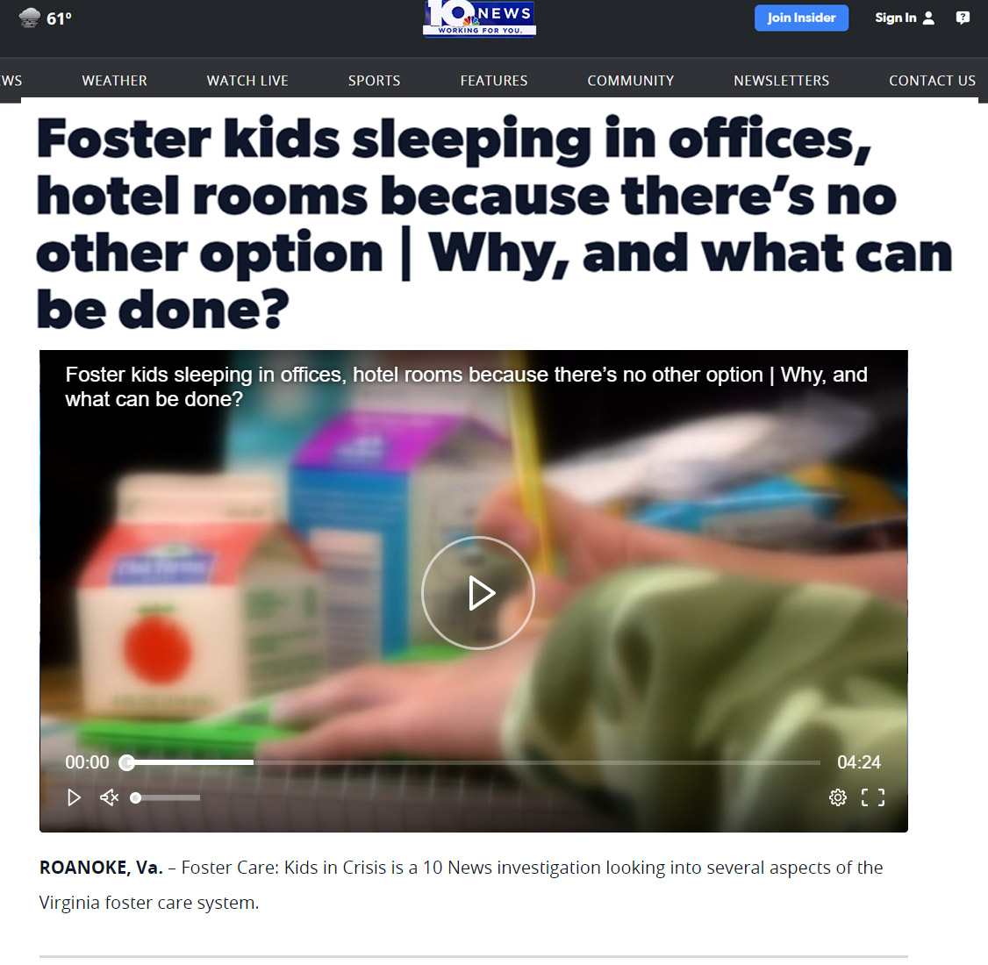
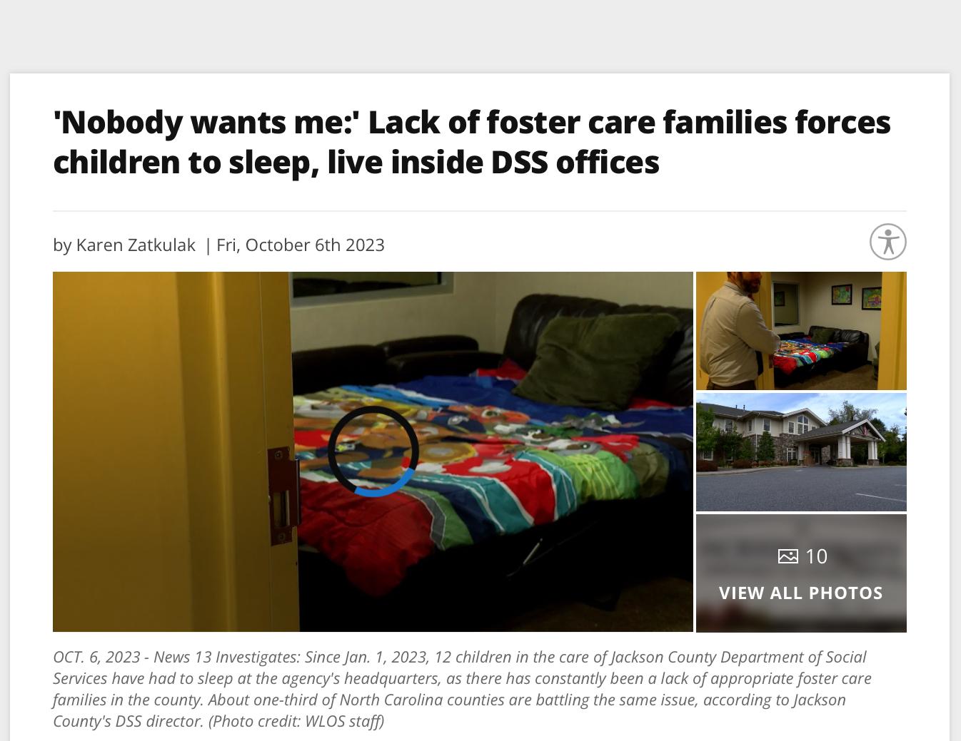
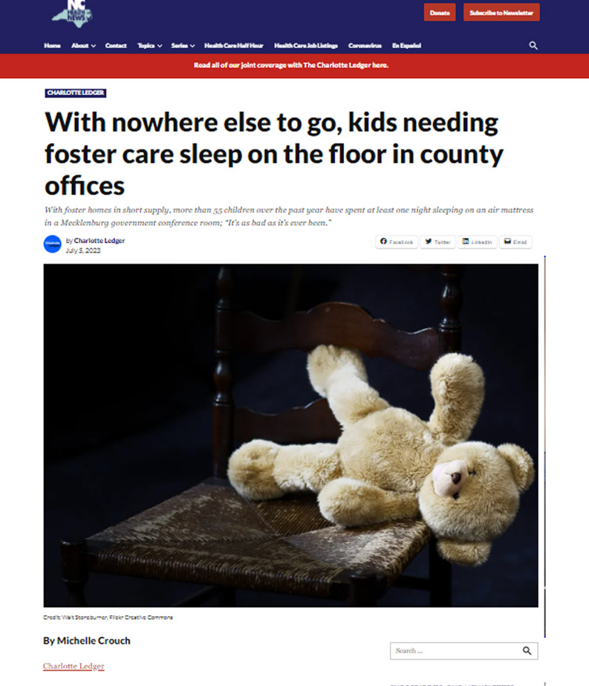

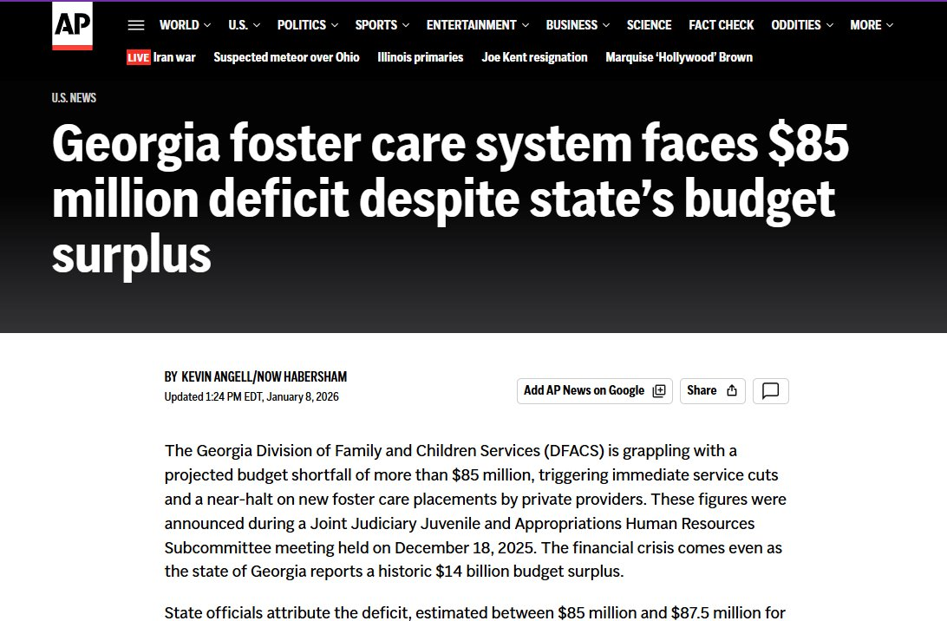
Crisis in the Country
Notes:
Just like I know, we have all seen these news articles.. This isn’t to highlight any state specifically but to showcase the problem.
High-acuity youth are among the most complex, costly, and underserved in any child welfare system.
High-acuity youth, roughly the top 5% of cases by complexity, generate costs that extend far beyond placement per diems.
They are teenagers cycling through unlicensed or emergency settings, approaching adulthood without a stable foundation, and consuming a disproportionate share of system resources.
The question facing child welfare professionals is not whether to act. It is whether a sustainable, replicable model exists that does not require unlimited funding or an abundant supply of licensed clinical staff.
We will present evidence from three programs, across our 3 pillars of services:
Thompson Family Forward (prevention)
Thompson Youth Stabilization (foster care support)
Crisis Stabilization Treatment Programs (MH/ residential).
Each program is built on the same foundational architecture: a trained, non-clinical workforce equipped through evidence-based practices, intentional integration of lived experience, and leadership design.
We know the workforce is getting smaller while the acuity and complexity of youth and family needs continue to increase.
• Our central message is simple: when systems create stability, they preserve workforce capacity, reduce avoidable cost, and improve outcomes for youth and families.
So let’s jump into the programs. Shawn take us away!

Slide 4
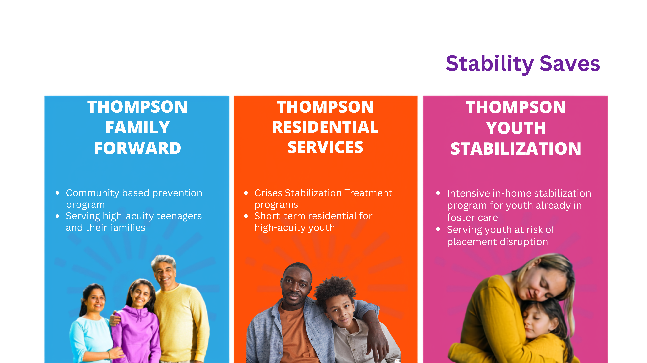



One Stability Framework
PREVENT CRISIS
• Respond before removal
• Strengthen families
• Address underlying needs
STABILIZE CARE
• Match support to acuity
• Build skills and safety
• Reduce escalation
SUSTAIN CONNECTION
• Support follows the youth
• Engage caregivers
• Preserve relationships
Notes:
Thompson Family Forward | Prevention
Thompson Family Forward is a community-based prevention program serving high-acuity teenagers and their parents at imminent risk of system involvement or foster care entry.
The program deploys Family Stabilization Specialists within 24 hours of referral for an average 90-day engagement. Services include crisis intervention, case management, life skills development, and connection to permanency and kinship supports.
The program's design addresses not only the presenting crisis but the underlying conditions that drive system entry: untreated trauma, parent-child conflict, school disruption, and unaddressed behavioral health needs. Thompson Family Forward has influenced system removal decision protocols and court diversion practices, to further impact the preservation of families.
Thompson Youth Stabilization (TYS) | Foster Care Support
Thompson Youth Stabilization is a short-term, intensive in-home stabilization program for youth already in the foster care system who have experienced three or more placement moves or are at risk of placement disruption. TYS responds within 24 hours of referral or within 2 hours if the youth is in office and provides multiple weekly on-site sessions until the youth achieves a minimum of 90 days of placement stability. Services include behavior coaching, safety planning, de-escalation, caregiver coaching, and 24/7 on-call crisis support. The program operates across Thompson's footprint in multiple Southern states.
What distinguishes TYS is its attachment to the youth rather than the placement. If a placement disruption occurs mid-episode, TYS continues to engage regardless of where the youth lands. Youth Partners, staff with direct lived experience in the system, serve as primary mentors. No master's degree is required for frontline roles; instead, staff are intensively trained and certified in Therapeutic Crisis Intervention, Motivational Interviewing, the CARE trauma model, and evidence-based safety planning.
Crisis Stabilization Treatment Program (CSP) | Residential
Thompson's Crisis Stabilization Treatment Programs provides short-term residential stabilization for high-acuity youth regardless of placement setting. Our CSP serves youth with the most complex behavioral, emotional, and trauma histories, often those transitioning from higher levels of care or who have exhausted community-based options. The average length of stay is approximately 60 days. Programs operate across Thompson's campuses and coordinate directly with stabilization programs to ensure transitions are intentional, not defaulted.
The CSP model is built on the same workforce architecture as the community programs: EBP-trained direct care staff, lived experience in leadership, and a design philosophy that keeps youth moving toward the least restrictive setting. Restrictive interventions are measured and minimized as a core quality indicator.

Slide 5
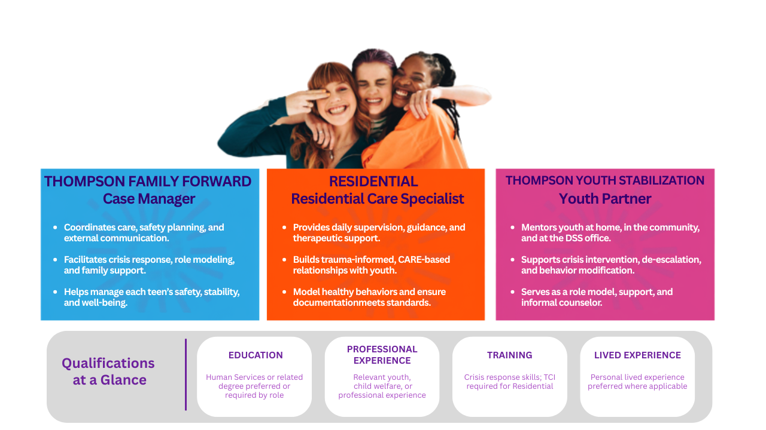
The Workforce Mix
Notes:
The Workforce Strategy: Why This Scales
The single most common reason high-acuity programs fail to scale is workforce. Programs built around master's-level clinical staff in frontline roles face a ceiling on growth and a floor on cost that most systems cannot sustain. Thompson's approach inverts this assumption deliberately.
Thompson's ability to achieve and sustain scale rests on three management commitments that are as important as any program model:
• Relentless investment in leadership development. Thompson builds program leaders from within. Supervisors are not administrators; they are clinical and operational mentors who drive fidelity, quality, and culture. This investment reduces turnover at the leadership level and ensures the model is carried by people who understand it from the inside.
• A comprehensive training infrastructure. Thompson's training department equips direct care staff with certifications in Therapeutic Crisis Intervention, Motivational Interviewing, the CARE trauma model, safety planning, and evidence-based behavior coaching. This infrastructure makes it possible to hire from a broader talent pool, including staff with lived experience, and still deliver consistent, high-quality services.
• A lean, swift administrative infrastructure. Overhead is designed to enable programs, not burden them. Thompson's administrative systems support rapid program launch, cross-site quality monitoring, and real-time data reporting, allowing the organization to expand into new geographies without proportionally expanding its administrative cost base.
This architecture is what makes the economics work. It also creates genuine career pathways for staff whose lived experience mirrors the populations served: youth who aged out of care, young adults who navigated the juvenile justice system, community members who understand the neighborhoods where these youth live. These staff are not a risk to manage. They are among the most effective experts in the field.

Slide 6

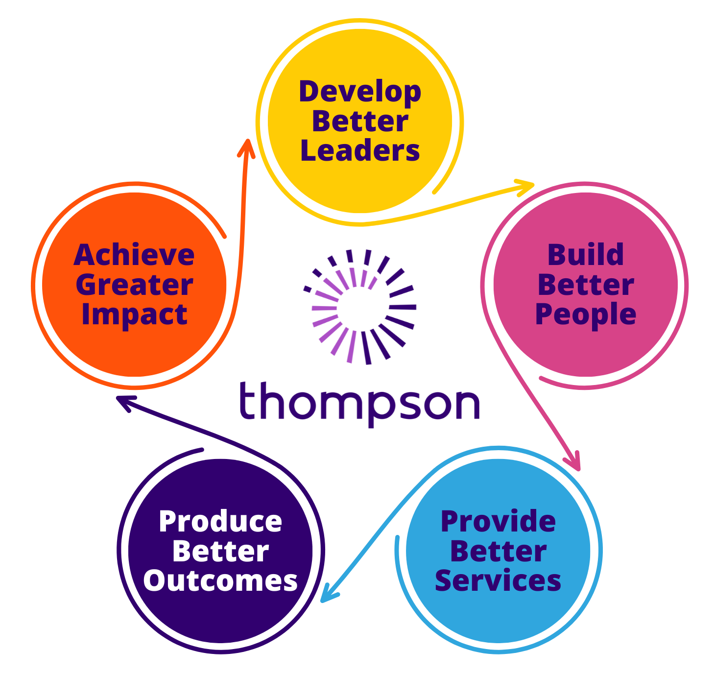
Relentless Investment in
Leadership Development
Leadership is the operating system that protects stability at scale.
1
Build leaders who understand the work
Develop leaders with credibility, practical knowledge, and commitment to the model.
2
Coach practice, quality, and culture
Supervisors reinforce expectations, inspect fidelity, and coach through pressure.
6
Align people, roles, and support
Use clear role expectations and coaching tools to strengthen leadership effectiveness.
Intentional leadership creates consistency for staff, youth, and families.
Notes:
Our Flywheel at Thompson is that it all starts and ends with leadership!
We live this. Even before leaders are hired, we start with utilizing Predictive Index and assessments. We review behaviors that we know are important for the role. We build interview guides to ensure we hire leaders, not excellent doers. We understand that the workforce needs strong leaders. We are in fact building succession plans at all times.
Our principle at Thompson is that 10% of learning is through training, 70% is on the job. We need to ensure leaders are leading the way.
• Training alone does not protect a model. Leaders carry, coach, inspect, and reinforce the work every day.
• Supervisors should function as clinical and operational mentors, not only administrators.
• Leaders reinforce expectations through coaching, staffing decisions, documentation review, incident response, quality monitoring, and how they lead under pressure.
• Funding and implementation must be designed together. Evidence-based models and approved pathways can help unlock federal or other funding, but the local design still has to fit the community need.

Slide 7
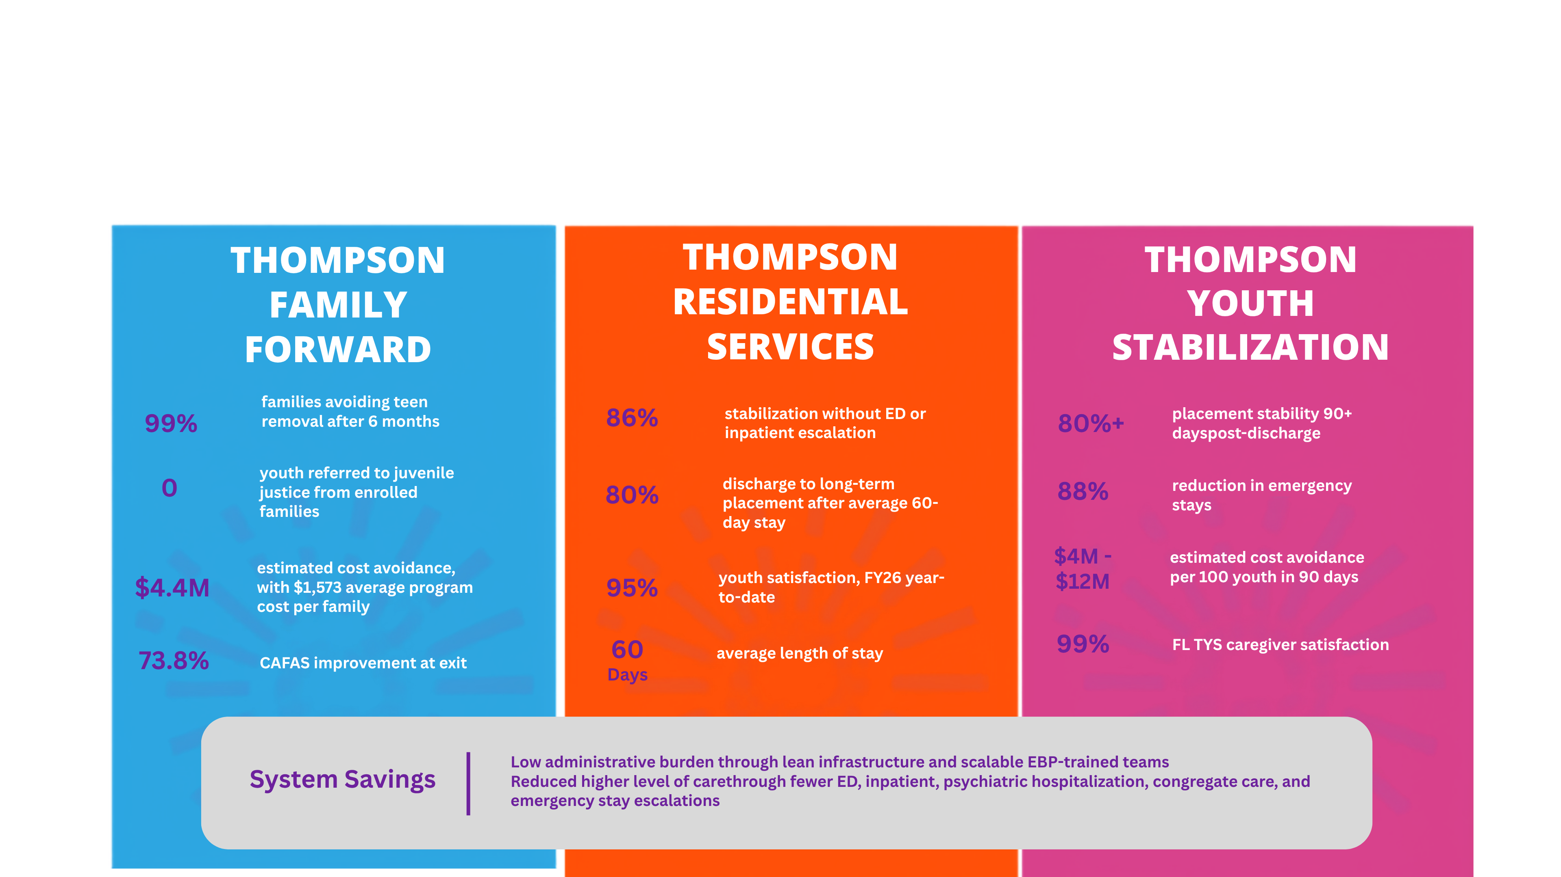
Outcomes
Notes:
TALKING POINTS
• Use selected outcomes as proof points, not as the entire presentation.
• Prevention outcomes demonstrate the value of intervening before system entry or removal.
• Stabilization outcomes demonstrate that consistent support can reduce placement disruption and reliance on emergency settings.
• Explain the fiscal value in broader terms than placement cost alone.
• Include workforce turnover, overtime, transportation, crisis response, supervision, administration, liability exposure, and lost capacity when discussing system savings.
• The key outcome question is not only whether one program performed well. It is whether the broader system became more stable for youth, caregivers, staff, and partners.
• Avoid spending presentation time explaining every metric. Use the data to reinforce the framework and move to application.
TFF Outcomes:
• Families avoiding teen removal (post-discharge preservation success after 6 months): 99%
• Youth referred to juvenile justice (DJJ referrals from enrolled families): 0
• Estimated cost avoidance (average program cost per family of $1,573 vs. average foster care episode of $59,189): $4.4M
• Families who met their identified goals: 91%
• CAFAS improvement at exit (post-discharge improvement): 73.8%
TYS Outcomes:
• Placement stability post-discharge, 90+ days (sustained across hundreds of youth served): 80%+
• Caregiver satisfaction, FY26 year-to-date (along with 95% youth satisfaction): 99%
• Reduction in emergency stays (youth no longer sleeping in shelters or unlicensed settings): 88%
• Estimated cost avoidance per 100 youth in 90 days: $4MM to $12MM
Crisis Stabilization Treatment Program (CSP) Outcomes:
• Stabilization without ED or inpatient escalation (during treatment, without emergency department or psychiatric hospitalization): 86%
• Discharge to long-term placement (average after a 60-day length of stay): 80%
• Youth satisfaction, CSP, FY26 year-to-date: 95%

Slide 8


Notes:
Closing message:
stability saves youth, preserves workforce capacity, and protects system resources.
CLOSING TALKING POINTS
• Where is instability creating the greatest human and financial cost in your system?
• What resources already exist but are not connected or fully used?

Slide 9




