Slide 1




When Placement Changes, Care Shouldn’t
Continuous, virtual-first healthcare built for youth and young adults impacted by
child welfare
Notes:
If I couldn't figure out the system- how can we expect anyone to?

Slide 2




I founded Here Now Health because as a digital health executive, CASA volunteer, and foster parent to more than 40 children, I experienced challenges from every direction.”
Our Story
Michelle Turner
Founder & CEO, Here Now Health
Notes:
people often ask us where our name came from- and it’s honestly the reason we are here
parenting philosophy- never wake a sleeping child

Slide 3








The Missing Middle
Delayed Access
Continuity Driven Care
Crisis Care
“This is the first time therapy felt like it was made for me.”
Low quality, long waitlists
Crisis and intensive care
-Here Now Patient (Aged Out Youth)
Long Wait
Crisis
Care Options

Slide 4







THE PROBLEM
Children impacted by child welfare get the wrong care, or no care at all, at the highest cost.
Real Example pulled from Facebook
Foster Parent Group
We got placement of a 5-year-old on Friday around 3 pm! She of course needs a well check, dentist, etc! EVERY appointment we try to make, including getting her into school, is giving us issues for not having her birth certificate and insurance info and stuff like that!!!! We are struggling...
ROOT CAUSES
Demand
Responsibility
Information
Continuity
Workforce
Higher medical & behavioral health needs often escalate to crisis
Caregivers are held accountable for care but have few options
Missing personal information & Medicaid cards block access
Children often relocate before securing an appointment
Few providers accept Medicaid & specialize in child welfare
10
55 Comments
RESULTS IN
10xCost
Healthcare costs are nearly 10-times their representation in Medicaid.
Notes:
Hardest parts of fostering was getting kids the right care at the right time
Spending 10X equates the difference between 3K and 30K
This drives terrible outcomes- everything from low graduation rates to high teen pregnancy to double incarceration rates
Not getting the right care at the right time has lasting impact

Slide 5













THE GAP
Why Care Breaks
Complex Barriers to Care
Delayed Access
Disrupted Continuity
Eligibility and intake barriers stall care
Care breaks with each placement move
Youth
Therapist
Fragmented Data
Limited Medicaid Network
Missing or inaccurate info prevents care.
Too few providers trained in child welfare
Bio Family
Judges
Caregivers
Case Managers

Slide 6







THE SHIFT
What Continuity Requires
The same four barriers, solved
Streamlined Access
Continuous Coverage
Fast, easy eligibility and intake.
Care moves with every placement.
Youth
Care Advocate
Therapist
Centralized Data
Specialized Workforce
We track and share key info across systems.
Child Welfare trained clinicians.
Bio Family
Caregivers
Case Managers
Judges

Slide 7









WHAT IT LOOKS LIKE
Access · Timely Care · Continuity · Caregiver Support
Covered by Medicaid, at no cost to families.
CURRENT STATE
No Medicaid Card?
No Care.
Care Starts
Anyway
DEDICATED CASELOADS
Children wait months or move before seeing a provider.
Low caseloads specifically dedicated solely to this population provide efficient virtual care.

Slide 8

WHAT IT LOOKS LIKE
Access · Timely Care · Continuity · Caregiver Support
Covered by Medicaid, at no cost to families.
CURRENT STATE
6+ Month Wait
for Therapy
Timely Care Reduces Crises
EVENINGS & WEEKENDS
Because they’re waiting so long, common needs go unmet, leading to crisis-driven ER visits.
Appointments within 24 hours with time reserved for youth in foster care

Slide 9


WHAT IT LOOKS LIKE
Access · Timely Care · Continuity · Caregiver Support
Covered by Medicaid, at no cost to families.
CURRENT STATE
Every Move Means Starting Over
Care Moves With Every Placement
INTENTIONALLY VIRTUAL
When placement changes, care stops. Youth start over with a new provider, or stop telling their story at all.
The same clinician continues through every move, with no new intake or waitlist.

Slide 10

WHAT IT LOOKS LIKE
Access · Timely Care · Continuity · Caregiver Support
Covered by Medicaid, at no cost to families.
CURRENT STATE
Caregivers Struggle without Guidance
Stable Placements Lead to Permanency
CAREGIVER SUPPORT
When minor issues pile up and develop into behavioral crises, caregivers feel helpless and overwhelmed.
Caregiver sessions and support lead to stable placements and permanency for young people.

Slide 11
HOW WE BRING THE RIGHT CARE WHEN IT’S NEEDED
The Game Plan
1
2
3
4
5
Medicaid covered
Care when it’s needed
Child welfare expertise
Intentionally virtual
Caregiver support
Uses the coverage every child in foster care already has. No cost to families.
A first appointment within 24 hours, not months on a waitlist.
Clinicians trained in trauma and the realities of foster care.
Care follows the child through every placement change.
Whoever is caring for the child gets support too, so placements hold.
The result: care that stays when placements change

Slide 12


WHAT HAPPENS WHEN CARE FOLLOWS THE CHILD
AVG. TIME TO FIRST AVAILABLE APPOINTMENT
24hrs
Care the Moment a Youth or Family Needs It
Compared to Medicaid
standard of 14 days
PLACEMENT STABILITY
90%
of caseworkers said it
helped placements stay stable
HIGHER LEVEL OF CARE PREVENTED
40%
I referred a youth to Here Now Health when their family was considering residential after recent inpatient stays. The weekly caregiver sessions alongside therapy made a clear difference, and the family is no longer pursuing residential care.”
of caseworkers said it
prevented higher-level care
CASEWORKER TIME SAVED
5hrs+
— HEALTH PLAN CARE MANAGER
saved per caseworker
each month

Slide 13
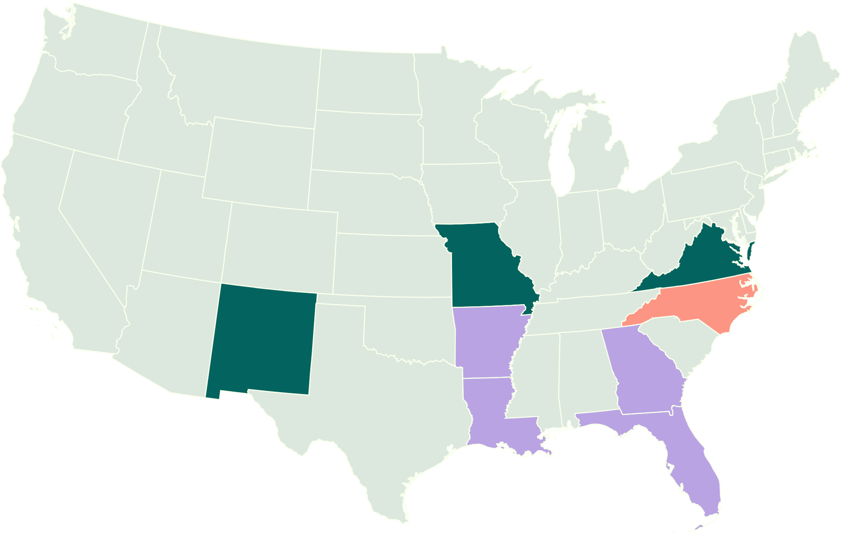



MEDICAID COVERED
Built with Medicaid Partners
Live
Virginia, Missouri, New Mexico
Launching
North Carolina
Medicaid approved
Arkansas, Louisiana, Georgia, Florida

Slide 14


Let’s build care that follows the child.
Every placement. Every time.
Notes:
This is a fixable problem. We have bipartisan support, states asking to be first, and a unique funding stream that lets us build a strong, sustainable business around Medicaid. We have already waited too long but I feel incredibly lucky to be building this. And I know we’re finally in a position to fix it.

